Slide 1

CATEINA
TECHNOLOGIES
Blockchain | Hybrid Integration | Artificial Integration | Internet of Things
A Journey to Collaborate & Grow
Est. 03rd Feb, 2019

Slide 2
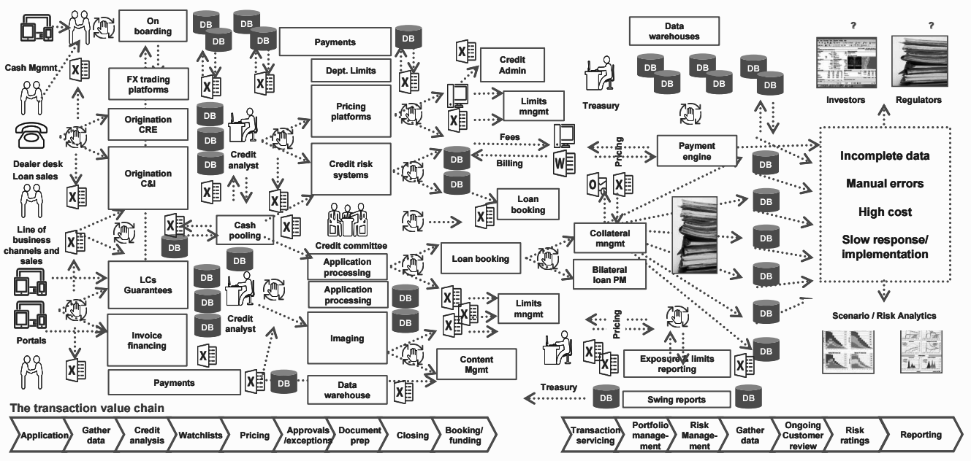
Banks Today - A $1 Trillion opportunity for disruption

Slide 3
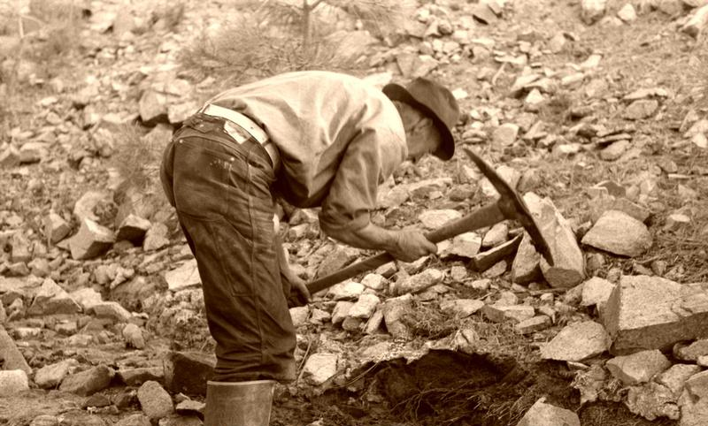
Fintech - The modern age Gold Rush

Slide 4
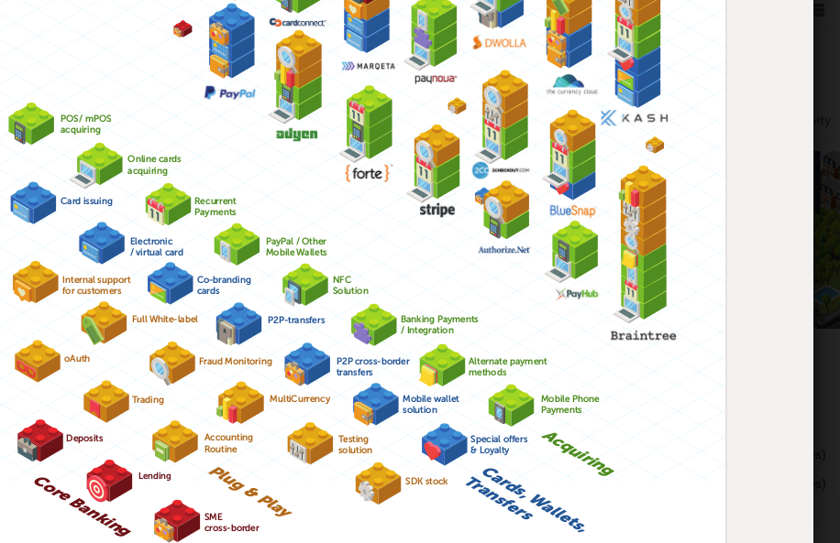
Banks Tomorrow - API Banking
Unbundling Banks, building revenue streams
What is possible to plug & play?
Banks as BaaS platforms and BaaS providers
Value Proposition for ecosystem partners
Technology as a Revenue driver, not a cost centre

Slide 5






The Next Wave - Community Compute FTW !!!
High level workflows
Distributed object storage holds HTML, CSS, Js etc.
Object Storage
Membership Service Registers and authenticates new users to the application
User Directory & Validation
The app’s Smart Contract backend receives dynamic API calls and performs business logic
API Gateway
Smart Contract
DLT Ledger
Serverless Compute FTW!!!
No SQL Database

Slide 6
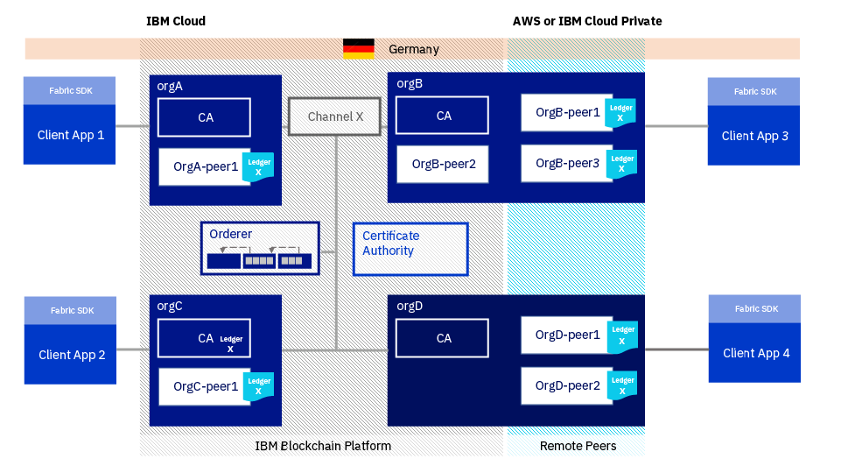
IBM Blockchain Platform

Slide 7

Why IBM Blockchain Platform?
Reduces risk | Saves time | Enterprise ready | Open
Flexible pricing and support options for all sizes of deployments Democratic governance policies to help prevent unauthorized network changes | Implement blockchain projects more quickly Extensive toolset for development, governance and operation of blockchain networks | Architected for High Availability and Disaster Recovery Highly secured and suitable for transactional workloads | Based on popular and open Linux Foundation Hyperledger technologies Avoid vendor lock-in! Embraces open source, open standards and open governance
Notes:
Covers the Why. This is the value proposition of IBM Blockchain Platform over other vendors’ platforms - as opposed to, say, the value of Hyperledger Fabric over Ethereum. "Reducing risk" is about IBM Support, and pricing structures that allow blockchain networks to start small and grow. It’s also about the reducing risk from a governance aspect - preventing malicious actors from tampering with the network. "Saving time" is about the use of development toolsets and patterns that help clients get value from blockchain quickly. "Enterprise-ready" is about the rock-solid, secure, performant base on which IBM Blockchain Platform is built. For some clients this might be the time to introduce the fact that IBM Blockchain Platform Enterprise Edition sits on the LinuxONE platform. “Open" is the counter to vendor lock-in, and points to the fact that IBM Blockchain Platform makes use of the Linux Foundation Hyperledger technologies.

Slide 8
Platform Value: Simplicity in the face of overwhelming complexity
 | IBM Blockchain Platform | Community Code Deployment
Inviting members | 5 seconds | 20 minutes per instance
Installing and instantiating smart contracts | Single click installation | 10 minutes per smart contract per peer
Deployment | Specify network parameters and automatically launch ordering service | Not available
Network alterations and additions | Add new members, channels and smart contracts through single clicks, text box or drop down via the UI | CLI driven, and more advanced skills required
Support | Complete support from the HW stack through the blockchain code base included | IBM support options available
Security | Secure container and highest level of security provided | Custom
Migration | Rolling migration and 99.999% availability provided under the covers | Not available
“IBM provides us with the easiest way to develop prototype blockchain applications for our clients. Thank you!”
-- Global consulting firm
“IBM has enabled our team to develop our blockchain demo with minimal hassle and gives us a clear path to scale with the tools to manage it”
-- Series backed start-up
Notes:
More details on the value that IBM Blockchain Platform adds.
To put it another way, IBM Blockchain Platform makes it a *lot* simpler to develop, deploy and operate your blockchain network.

Slide 9
Qarthage Platform
CA
Orderer
Peer
API
Bank / Admin
Client
Audit
Network topology for the Qarthage Platform
Audit
API
Buyer – Supplier Channel
API
Peers
Peers
Client
Client
Optional Nodes
Buyer
Supplier
Peers
Peers
CA
CA
API
API
Client
Client
Regulator
Auditor/Validator
CA
CA
Notes:
Solution network architecture
Add validate functionality

Slide 10





Unhindered Execution
Comparing non-blockchain and blockchain driven scenarios
The program maintains the only ledger of record for its transactions and connects to each partner independently
The program has no visibility as to what happens once its currency is converted to a partner’s
Earn/burn transactions and exchanges take days or weeks to post in member accounts
All programs maintain a distributed ledger of all transactions and exchanges, and all partners are connected on the blockchain platform
All programs can track how currency is earned, burned, and transferred across the network
Earn/burn transactions and exchanges are posted instantly to accounts
Notes:
How to adopt blockchain from legacy? See badges on next

Slide 11



Blueprint of a Contract
Using Blockchain to build the cornerstone of the trust stack
Presentation
Presentable img signed by Issuer’s key
Content
Receipt
Achievement metadata bearing Issuer Signature & programmable criteria
Receipt on Blockchain & Recipient JSON file

Slide 12
Asset Provenance
Government
Committee
Beneficiary
Validator
Auditor
Funder 1
Funder 2
Funder 3
Funder 4
Project
Project Milestones / Activities
V
A
Funds
Government Creates Project
Milestone 3
Activity 5
Invoice
Government Defines Milestone / Activity
Committee Approves Budget for Milestone / Activity
Milestone 2
Activity 4
Government Publishes the Project
Invoice
V
A
Funders Funds the Project
Beneficiary Requests for Funds
V
A
Milestone 2
Activity 3
Government Releases Funds
Invoice
Beneficiary Consumes the Funds
Beneficiary submits proof
V
A
Milestone 1
Activity 2
Invoice
Validator validates proof
Auditor reviews Project
V
A
Milestone 1
Activity 1
Invoice
Government closes Project

Slide 13

Decision Tree
A. Are you trying to remove intermediaries or brokers?
B. Are you working with digital assets (versus physical assets)?
C. Can you create a permanent authoritative record of the digital asset in question?
D. Do you require high performance, rapid (~millisecond) transactions?
Blockchain can’t do this efficiently yet, but solutions are in development
Do not use blockchain
E. Do you intend to store large amounts of non-transactional data as part of your solution?
F. Do you want/need to rely on a trusted party? (e.g., for compliance or liability reasons)
G. Are you managing contractual relationships or value exchange?
H. Do you require shared write access?
I. Do contributors know and trust each other?
Blockchain
Beyond the Hype
Are contributors interests unified or well-aligned?
Blockchain may work – further research is needed
J. Do you need to be able to control functionality?
Strong case
for blockchain
(private/ permissioned ledger)
For any organization, blockchain technology should not be a goal in itself but a tool deployed to achieve specific purposes.
Strong case
for blockchain
(public ledger)
K. Should transactions be public?

Slide 14
Characters of high potential use cases
Multiple Writers
Minimal trust
Intermediaries
Transaction
dependencies
Shared
Repository
More than one entity generates
transactions that require
modifications to the shared
repository
A level of mistrust exists between
entities that generate transactions
One (or multiple) intermediary or a
central gatekeeper is present to enforce trust
Interaction or dependency between
transactions is created by different
entities.
A shared repository of information is
used by multiple parties

Slide 15
Key Takeaways
It takes a village to raise a child
Notes:
«Fintech bank» is a value ecosystem. It’s not feasible or viable (and perhaps even necessary) for a bank to provision every product or service that a customer may need, but it can very well be the channel through which the product is provisioned by another party. Platforms will be about ‘coopetition’ as much as they are about competition.

Slide 16

Key Takeaways
Selling shovels during a gold rush is a great way to make money

Slide 17








Our Customers

Slide 18
Company Contacts
Address
www.cateina.com
Unit No. 7,8, JK Tower, Phirojshah Nagar Road, Vikhroli (East), Mumbai - 400083
google.com/+cateinatech
Phone
+91 9867767642
twitter.com/cateinatech
Email
info@cateina.com
facebook.com/cateinatech

